Slide 1
Unit -5
Mechatronics
Robotics

Slide 2
Syllabus
Mechatronics: Introduction: Evolution of Mechatronic system, measurement & control system, basic elements of control system, Applications-water level controller, washing machine, Engine management system (EMS), Antilock
Braking System (ABS).
Robotics: Robots- Basic Structure of Robots, Robot Anatomy, Complete Classification of Robots, Fundamentals about Robot Technology, Basic Robot Configurations and their Relative Merits and Demerits.

Slide 3
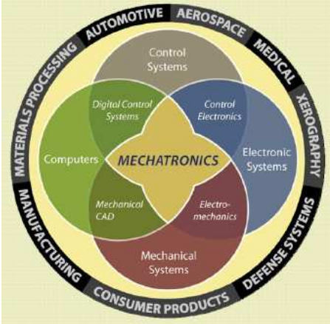
Introduction to Mechatronics
The term “Mechatronics” was coined in 1969 by a senior engineer of a Japanese Yasakawa Electric Company to refer to the use of electronics in mechanical control.
Mechatronics is defined as the synergistic integration of mechanical engineering with electronics and intelligent computer control in the design and manufacturing of products and process

Slide 4
Evolution of Mechatronic system
1960s: The term "mechatronics" was coined in Japan by combining "mechanics" and "electronics." Early systems were primarily automated machines controlled by basic electronic circuits. Example applications included simple assembly line equipment and timers.
1970s-1980s: Introduction of microprocessors and microcontrollers revolutionized mechatronics. Systems became more compact, reliable, and capable of handling complex processes. The integration of sensors and actuators allowed for more accurate monitoring and control.
1990s: Advances in computational power and software algorithms led to sophisticated real-time control systems. Communication protocols and data acquisition tools further enhanced the integration of components.
2000s-Present: The rise of Industry 4.0, Internet of Things (IoT), Artificial Intelligence (AI), and robotics has brought intelligent and interconnected systems to the forefront. Modern mechatronic systems can learn, adapt, and optimize themselves for various applications, ranging from smart homes to autonomous vehicles.

Slide 5
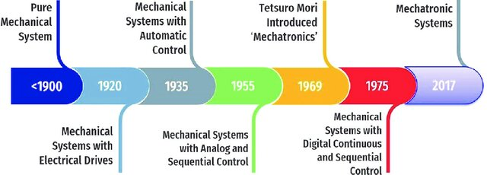
Evolution of Mechatronic system

Slide 6
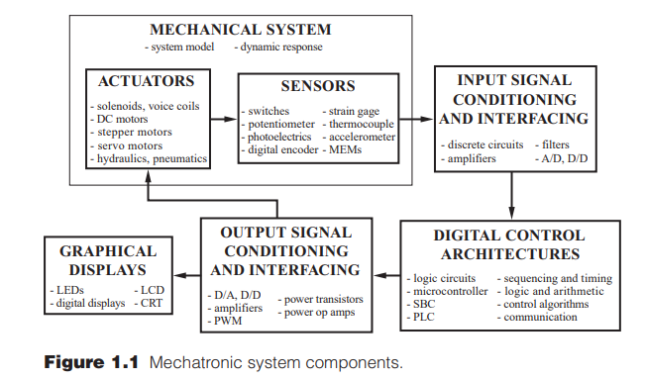
Mechatronics System Components

Slide 7
Mechatronics System Components
Fig 1.1 illustrates all the components in a typical mechatronic system. The actuators produce motion or cause some action, the sensors detect the state of the system parameters, inputs and outputs , digital devices control the system, conditioning and interfacing circuits provide connections between the control circuits and the input/output devices and graphical displays provide visual feedback to users.
Sensors and actuators are key components of mechanical systems.
Actuators generate motion or actions, while sensors detect system parameters, inputs, and outputs. Types of actuators include pneumatic, hydraulic, electro-mechanical actuators, and motors such as DC, AC, stepper, servomotors, and piezoelectric actuators.
Sensors in mechatronic systems include linear and rotational sensors, acceleration sensors, force, torque, pressure, flow, temperature, proximity, and light sensors.

Slide 8
Mechatronics System Components
Signals and Conditioning: Mechatronic systems handle input and output signals. Sensors and interfacing devices send input signals to control circuits via amplifiers and A/D or D/D converters. Output signals are sent to displays or devices through D/A converters, decoders, amplifiers, and power transistors.
Digital logic devices control overall system operation. The various digital logic systems used in the mechatronic system are logic circuits, microcontrollers, programmable logic controllers, sequencing and timing controls, and control algorithms.
Software and Data Acquisition: Data acquisition systems collect sensor outputs (voltage, frequency, resistance) and input them into a microprocessor or computer. Software controls data acquisition through DAC boards. These systems include multiplexers, amplifiers, registers, control circuits, and DAC boards, with examples like data loggers and computers with plug-in boards.

Slide 9
Mechatronics System Components
Computers are used to store a large number of data and process further through software. Display devices are used to give visual feedback to the user. The various display devices used in the mechatronic system are LEDs, CRT, LCD, digital displays, etc.

Slide 10
Phase of Mechatronic system design process
Modeling/Simulation
Prototyping
Deployment/Life Cycle
Recognition of the Need
Hardware-in-the-Loop Simulation
Deployment of Embedded Software
Conceptual Design and Functional Specification
Design Optimization
Life Cycle Optimization
First Principle Modular Mathematical Modeling
Sensor and Actuator Selection
Detailed Modular Mathematical Modeling
Control System Design
Design Optimization

Slide 11
Phase of Mechatronic system design process
MODELING / SIMULATION
1. Recognition of the need- In the context of simulation or modeling of a car, the recognition of need involves identifying the specific problem or scenario that the simulation of car aims to address. It's the initial step where you define what you want to simulate and why, laying the foundation for the modeling process.
2. Conceptional design and functional specification- Conceptual design of a car involves outlining the high-level structure and key elements of the model. It's about defining the overall framework of a car before delving into specifics. Functional specification, on the other hand, details how the model of a car will operate, specifying its functions, features, and interactions. Together, these steps provide a roadmap for developing a detailed and effective model and simulation.
3. First-principle modular mathematical modeling- With respect to a car. it refers to a systematic approach where a complex system is broken down into fundamental principles or basic components. Each component is represented mathematically based on first principles, which are the fundamental laws or equations governing the system. The modular aspect involves organizing these mathematical representations into modules, making it easier to manage and understand the overall system.

Slide 12
Phase of Mechatronic system design process
MODELING / SIMULATION
4. Sensor and actuator Selection- A sensor is defined as a device in a car that receives a signal or stimulus and responds to it by generating an electrical signal. The output signals correspond to some forms of electrical signal, such as current or voltage, which can be easily measured.
5. Detailed Modular Mathematical Modeling- Develop mathematical equations based on physics
principles. - Examples: Forces, torques, displacements.
6. Control System Design- The control system design process of a car involves specifying system
requirements, creating a mathematical model, designing a controller to meet those specifications and analyzing system performance through simulations or experiments. It typically follows a cycle of design, analysis, and refinement to achieve desired control system behavior.
7. Design optimization- in the context of mechatronic system prototyping of a car includes: Iterative Improvements: Refining the system design through successive iterations to enhance performance

Slide 13
Phase of Mechatronic system design process
PROTOTYPING
8. Hardware in Loop Simulation: In a car, it is a crucial aspect of the prototyping phase in mechatronic system design. It involves: Integration of Real Hardware: Connecting physical components or subsystems with simulation software.
9. Design Optimization- Design optimization in a car involves defining design objectives and constraints, creating mathematical models to represent the design space, employing optimization algorithms to search for the optimal solution, and iteratively refining the design based on the obtained results.

Slide 14
Phase of Mechatronic system design process
DEPLOYMENT/LIFE CYCLE
10. Deployment of embedded software: The development cycle for embedded software in a car typically involves stages like requirements analysis, design, coding, testing, and debugging. After thorough testing, the software is deployed onto the embedded system, ensuring it meets performance and reliability criteria. The deployment process may vary based on the specific embedded platform and project requirements.
11. Life cycle optimization: The development cycle optimization of a car involves refining and streamlining processes throughout the software development life cycle. This includes continuous improvement in areas like planning, coding, testing, and deployment to enhance efficiency, reduce errors, and ensure timely delivery of high-quality software.
Dr. Gangadhar Angadi (GT&TC, BE, MTech and PhD), Assistant Professor, Dept. of Mech. Engg., RV College of Engineering, Bangalore-560059

Slide 15
Comparison Of Traditional and Mechatronic Design
TRADITIONAL | MECHATRONICS
Sequential approach | Concurrent approach
Process controlled by relay logic | Microprocessor based programmable logic controller
More wiring to control computer and control room | Reduced wiring and machine cycles stored and executed via local control loops
Manual handling processes for loading and unloading | Use of general purpose robotic for handling; automatic tool changing
Maintenance on a preventive or breakdown basis | Based on in-line diagnostics and condition monitoring
Dr. Gangadhar Angadi (GT&TC, BE, MTech and PhD), Assistant Professor, Dept. of Mech. Engg., RV College of Engineering, Bangalore-560059

Slide 16
Control System
A control system in mechatronics refers to a system that manages, commands, directs, or regulates the behavior of devices or systems to achieve desired outputs. It plays a central role in integrating mechanical, electronic, and computational components in a cohesive manner.
Example:
      Central heating system
      Domestic washing machine
      Safety lock system
Two basic forms of control systems are open loop and closed loop

Slide 17
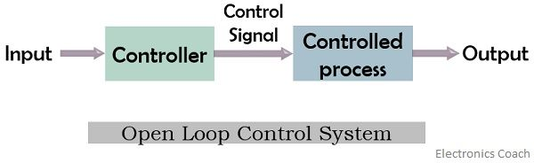
Control System
Open Loop Control System
An open-loop control system operates based on predefined instructions without using feedback to adjust its performance.
Characteristics:
No Feedback: The system does not compare output with the desired result.
Simpler Design: Easier to implement, with fewer components.
Non-Adaptive: Cannot respond to changes in external conditions or disturbances.
Predefined Operation: Works based on set commands or time-based inputs.

Slide 18
Control System
Open Loop Control System
Advantages
Simple and cost-effective.
Easier to design and implement.
Faster response since no feedback loop is involved.
Disadvantages:
Limited accuracy and precision.
Unable to correct errors or adapt to disturbances.
Less reliable in complex or variable environments.
Examples:
Washing machines (with fixed cycles).
Electric ovens (set to a specific time and temperature).
Traffic lights (on a timed sequence).

Slide 19
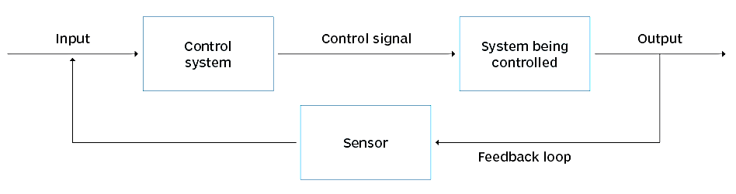
Control System
Closed Loop Control System
A closed-loop control system uses feedback to compare the actual output with the desired output and makes adjustments to minimize the error.
Characteristics:
Feedback Mechanism: Continuously monitors output and adjusts input accordingly.
Higher Complexity: Includes additional components like sensors and feedback loops.
Adaptive: Can respond to external changes and disturbances.
Error Minimization: Works to reduce the difference between actual and desired outputs.

Slide 20
Control System
Closed Loop Control System
Advantages:
High accuracy and precision.
Can correct errors dynamically.
Reliable in varying conditions or environments.
Disadvantages:
More complex design and implementation.
Higher cost due to additional components (sensors, controllers).
Slower response time in some cases due to feedback processing.
Examples:
Air conditioning systems (maintain a set temperature).
Autonomous vehicles (adjust steering and speed based on environment).
Servo motors in robotic arms (precise positioning and movement).

Slide 21
Control System of a Mechatronic System
  The control system for a mechatronic system can be classified as either a discrete event control system or a feedback control system.
  In discrete event system, the controller controls the execution of a sequence of events.
  In a feedback control system, the controller controls one or more variables using feedback sensors and feedback control laws.
  Example: Automatic washing machine, Automatic camera.

Slide 22
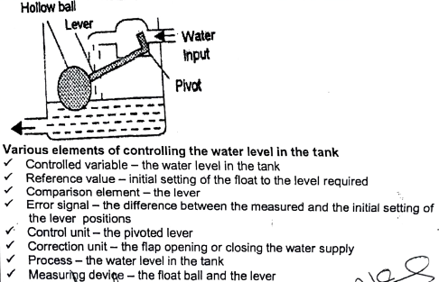
Mechatronic System
Water level

Slide 23
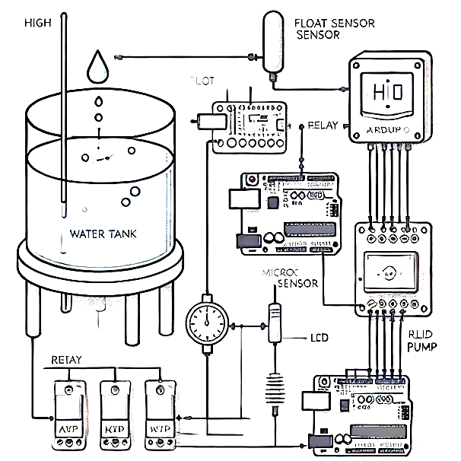
Mechatronic System
Water level
The water level controller operates based on feedback from sensors and decisions made by a microcontroller or programmable logic controller
1. Monitoring the Water Level
Sensor Activation:
Sensors (e.g., float, ultrasonic, capacitive, or pressure sensors) continuously monitor the water level in the tank or reservoir.
The sensor generates a signal proportional to the water level. For example:
A float sensor sends ON/OFF signals based on its position.
An ultrasonic sensor emits sound waves and calculates the distance to the water surface based on the time taken for the echo to return.
Data Transmission:
The sensor output is sent to the microcontroller or PLC for processing. This may be an analog signal (e.g., from an ultrasonic or pressure sensor) or a digital signal (e.g., from a float switch).

Slide 24
Mechatronic System
Water level
2. Data Processing
Microcontroller/PLC Function:
  The controller reads the sensor input and compares it against predefined thresholds:
    Low Level: If the water level falls below a minimum threshold.
    High Level: If the water level reaches or exceeds the maximum threshold.
  Decision-making algorithms within the controller determine the next course of action based on the water level.
3. Controlling the Actuator
Pump Activation:
  If the water level is below the minimum threshold, the controller activates the water pump via a relay or a motor driver circuit.
  The pump draws water from a source (e.g., a well or pipeline) and fills the tank.
Pump Deactivation:
  When the water level reaches the maximum threshold, the controller sends a signal to deactivate the pump, stopping the water inflow..

Slide 25
Mechatronic System
Water level
4. Safety Mechanisms
Dry Run Protection:
  If the pump is running but no water is being drawn (e.g., the source is empty), the controller detects this condition using sensors or feedback from the pump and shuts it down to prevent damage.
Overflow Prevention:
  If the sensor detects water beyond the maximum level (indicating a potential malfunction), the system triggers an alarm and shuts off the pump immediately.
5. User Interface
Display:
  The controller may be connected to an LCD, LED, or graphical display to show the current water level and system status.
Alarms:
  Audible or visual alarms may alert the user in case of anomalies, such as low water levels, pump malfunctions, or overflows.

Slide 26
Mechatronic System
Water level
6. Continuous Monitoring and Feedback Loop
The system continuously monitors the water level and adapts in real-time, maintaining an optimal water level in the tank.
Feedback loops ensure the system is responsive to changing conditions, such as fluctuations in water demand or supply.

Slide 27
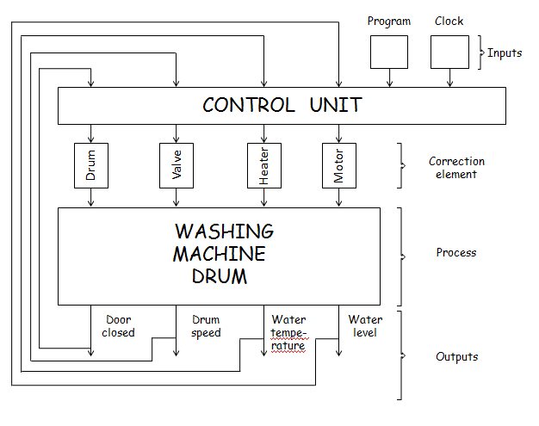
Mechatronic System
Automatic Washing Machine

Slide 28
Mechatronic System
Automatic Washing Machine
Inputs:
The program in a washing machine represents the specific set of instructions or a pre-defined sequence of actions that the machine follows during a wash cycle.
These instructions dictate the duration, water temperature, agitation pattern, spin speed, and other parameters of the washing process.
The clock in this context refers to the timer or timing mechanism within the washing machine. It manages the duration of each phase of the washing cycle.
.

Slide 29
Mechatronic System
Automatic Washing Machine
Correction elements:
1. Drum: It is the part of the machine where clothes are placed for cleaning. The design and function contributes to the effectiveness of washing
2. Valves: play a crucial role in controlling the flow of water into and out of the machine. There are generally two types of valves involved: the water inlet valve and the drain valve.
      Water valve:- The water inlet valve is responsible for controlling the flow of water into the washing machine.
      Drain valve:- The drain valve is responsible for removing used water from the washing machine after the washing and rinsing cycles.
3. Heater: the heater in an automatic washing machine contributes significantly to the cleaning efficiency and versatility of the appliance. It allows users to customize their washing experience by selecting the appropriate water temperature for different types of clothes and laundry requirements.
4. Motor: Its primary role is to provide the necessary power to move and control the motion of different parts of the washing machine.

Slide 30
Mechatronic System
Automatic Washing Machine
Outputs:
1. Door closed:- the door of the washing machine must be closed because it helps in water containment, user safety ,temperature safety and operational safety.
2. Drum speed:- . The speed of the drum is controlled by the washing machine's motor, and it can vary during different phases of the washing cycle and also the drum speed may be changed depending upon the fabrics that are being washed.
3. Water temperature:- the water temperature in an automatic washing machine is a versatile tool that users can leverage to achieve the desired cleaning results while considering factors such as stain removal, fabric care, energy efficiency, and the specific needs of different types of laundry loads.
4. Water level:- the water level in an automatic washing machine is a key parameter that users can adjust to optimize cleaning performance, water efficiency, and energy efficiency. Maintaining correct water level prevents water leakage and overloading.
Process:
1. Loading
2. Detergent Dispensing
3. Water Inlet
4. Agitation
5. Soaking
6. Drainage
7. Rinse Cycle
8. Drainage (Again)
9. Spin Cycle
10. End of cycle

Slide 31
Mechatronic System
Automatic Washing Machine
Pre wash cycle involves the following sequence of operations
Opening the valve to fill the drum when a current is supplied
Microprocessor is used to operate the switch for opening and closing the valve
Closing the valve after receiving the signal from a sensor when the required level of water is filled in the washing drum
Stopping the flow of water after the current is switched off by the microprocessor
Switch on the motor to rotate
Initiate the operation of pump to empty the water from the drum
Pre wash cycle involves washing the clothes in the drum by cold water

Slide 32
Mechatronic System
Automatic Washing Machine
Main wash cycle involves washing the clothes in the drum by hot water and the sequence of operations in main wash are follows
Cold water is applied after the pre wash cycle is completed
Current is supplied to switch on the heater for heating the cold water
Temperature sensors switch off the current after the water is heated to required temperature
Microprocessor or cam switch on the motor is used to rotate the drum
Microprocessor or cam switches on the current to a discharge pump empty the drum

Slide 33
Mechatronic System
Automatic Washing Machine
Rinse cycle involves washing out the clothes with cold water and number of times and the sequence of operations as follows
Opening of valve to allow cold water into the drum when the microprocessor gives signals to supply current after the main wash cycle is completed
Switches off the supply current by signals from microprocessor
Operation of motor to rotate the drum
Operation of pump to empty the drum and repeat the sequence a number of times
Spinning cycle involves removing of water from the clothes and the sequence of operations is carried out switching on the drum motor to rotate it to a higher speed than the rinsing cycle

Slide 34
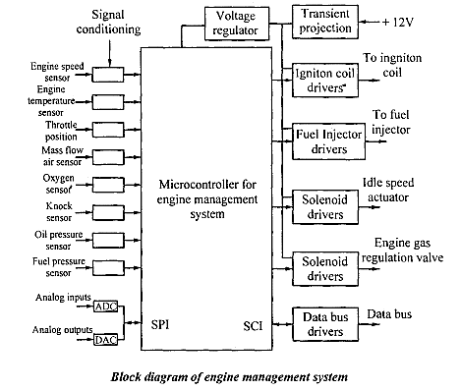
Mechatronic System
Engine Management System

Slide 35
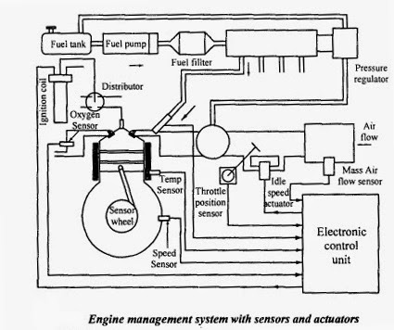
Mechatronic System
Engine Management System

Slide 36
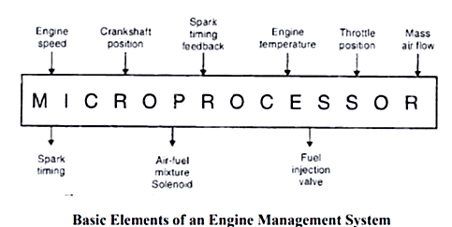
Mechatronic System
Engine Management System
In a modern car operations are carried out through a microprocessor.

Slide 37

Mechatronic System
Engine Management System

Slide 38
Mechatronic System
Engine Management System
Electronic Control Unit: It controls more than one electric systems and subsystems in a motor vehicle. It helps in regulating and maintaining the amount of fuel
and air the engine need to increase horsepower.
Fuel Injector Sequential: a type of multi-port injection system in which injection valve will open just before the cylinder intake valve opens. It has the fast response time when the driver makes a quick change.
Air Flow Sensor: An air flow meter is a device that measures the actual speed of the air flowing through the engine in different segments.
Air Temperature Sensor: It helps to measure the air density for fuel mixture control and to trim the air flow ratio according to the airflow density.

Slide 39
Mechatronic System
Engine Management System
Throttle Position Sensor: This sensor is used to monitor the throttle position of a car. This sensor moves with the throttle and sends a voltage signal to the computer. Thus indicating throttle angle and speed of movement. The computer uses this data to measure engine load, adjust timing, fuel delivery etc
Temperature Sensor: Temperature sensors include analog and digital sensor ICs designed for temperature monitoring of a system.
Oxygen Sensor: It measures the proportion of oxygen to fuel in the engine.
Idle Air Control Valve: The idle air control valve is also known as idle speed control valve; regulates the idle speed of the engine.
MAP Sensor: This sensor measures air pressure which tells engine the current altitude of a vehicle.
Knock Sensor: The Knock Sensor detects engine knock and sends a voltage signal to the engine and the engine uses that signal to control the timing

Slide 40
Mechatronic System
Engine Management System
Engine Speed Sensor: An engine speed sensor is attached to crankshaft of car's engine and it indicate the speed that crankshaft is spinning. This information is beneficial to control both the ignition timing and EMS.
Engine Oil Sensor: It measures the oil pressure inside the engine and gives an alert in case of any problem with oil pressure.
Crankshaft Sensor: It is used to monitor the position and rotational speed of crankshaft and this information will be used by the EMS to control the ignition system timing and other engine parameters.
Camshaft Sensor: The Camshaft sensor determines which cylinder is firing to establish injector synchronization and coil firing sequence in DIS systems then only crankshaft sensor set ignition timing, supply the signal and measure the speed

Slide 41
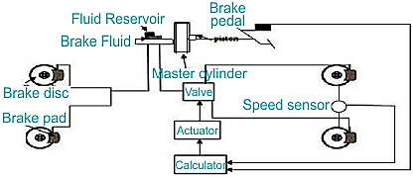
Mechatronic System
Antilock Braking System

Slide 42
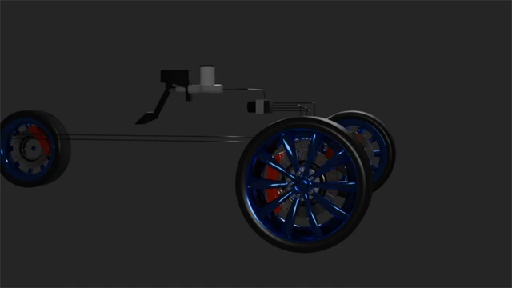
Mechatronic System
Antilock Braking System

Slide 43
Mechatronic System
Antilock Braking System
The Electronic Control Unit (ECU) of the ABS reads signals from each wheel's speed sensors.
When the driver applies the brakes abruptly, the wheel decelerates rapidly, increasing the risk of wheel locking.
To counter this, the ECU detects the sudden speed decrease and signals the valve to close, reducing pressure on the brake pad and preventing wheel lock.
As the wheel starts to accelerate again, another signal prompts the ECU to open the valve, increasing brake pad pressure and slowing down the wheel.
This cycle of brake application and release occurs about 15 times per second during hard braking, effectively preventing wheel lock and eliminating vehicle skidding.
With ABS, drivers can steer the vehicle while braking, significantly reducing the risk of collisions.

Slide 44
Robotics

Slide 45
ROBOT
The word robot was first coined by Czech novelist KAREL CAPEK in 1920’s. The word robot means a servant or a worker. However, this was just a word coined but the actual technological development in the field of robot was first noted in the year 1957 by English inventor CYRIL WALTER KENWARD developed a manipulator that could move in x-y-z axes system.

Slide 46
BASIC ELEMENTS OF ROBOT
or ROBOT ANATOMY
The basic elements of industrial robots are manipulator, controller, end effector, sensors and energy source:-
1. Manipulators: It comprises of base, arm, wrist are the most obvious parts of a robot. The robot movements are executed by the mechanical parts like links, power joints and transmission system along with internal sensors housed within the manipulator.
2. Controller: The controller acts like a brain of robot. It performs the functions of storing and sequencing data in memory, initiating and stopping the motions of manipulators and interacting with environment.
3. End effectors: End effector is the tool, a sort of gripper which directly interacts with the job. Grippers are being designed to handle a wide range of part configurations. The gripper is similar to human hand. Just the hand grasps the tool to perform the work; the gripper secures the robot’s work piece while the operation is being performed. The shape of the gripper is determined by the task it has to perform. These include tools designed to weld, paint or perform machining operations such as milling and grinding.
4. Actuators: Just as the human body requires muscles the robot arm requires actuators to move the manipulators. The actuators are devices that exert force to drive the manipulator into a predetermined position or series of positions and hold the joint rigidly once the position is reached. There are two types of actuators. Angular and linear. Angular actuators rotate their loads. Linear actuators extend their loads. The classification of actuators is related to the type of power they use. Electrical actuators use electrical power, hydraulic actuators use hydraulic power and pneumatic actuators use pneumatic power.

Slide 47
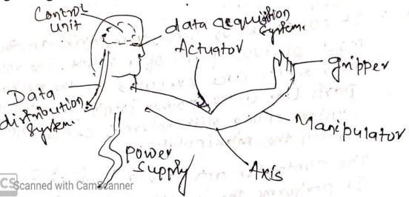
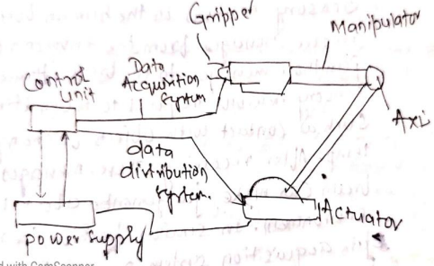
BASIC ELEMENTS OF ROBOT
or
ROBOT ANATOMY

Slide 48
BASIC ELEMENTS OF ROBOT
or
ROBOT ANATOMY
5. Axes/Joints/ Degree of freedom: While the manipulator provides the support needed there must be flexible joints in the system to follow for movement in different directions. The axes are flexible joints in the system to allow for movement in different direction. The axes are flexible pivots in the mechanical skeleton that allow the bending of structure at that point.
6. Power supplies: Just as human digestive system converts food into usable energy the robot power supply provides the actuators and control unit with the energy that they need to function. The energy must be in the form that a robot system can use. If the actuators are hydraulic and the workplace only has electrical power available, then the power supply must convert this electrical energy into hydraulic energy.
7. Data distribution system: In the human body neurons receive messages from the brain and passage those messages to the muscles. In the same way the data distribution system receive messages from control unit and passes them on to the actuators.
8. Data acquisition system: Sensory neurons in the human body receive messages from the environment and pass those messages to the brain. Human sensory neurons respond to touch stimuli such as contact with objects or change in temperature. After receiving these messages, the brain can make judgements about the environment. In similar fashion, the robotic data acquisition system receives messages from environment and passes those messages into control unit.

Slide 49
ROBOT
Robot definition: The Robot Institute of America in 1979 defined a Robot as follows:
A Robot is a reprogrammable, multifunctional manipulator designed to move material, parts, tools or specialized devices through variable programmed motions of performance of a variety of tasks.
A robot that is used to perform tasks in industries is called as an "industrial robot". An industrial robot can perform wide range of industrial tasks like loading, unloading, welding, painting, inspection, assembly, material transfer, etc.
Robotics definition: Robotics can be defined "as a field of technology that deals with the conception, design, construction, operation and application of robots".

Slide 50
ROBOT
But why a robot is required when a human can perform the tasks? That is because of the following qualities:
Robots can work in hazardous or dangerous environments such as a nuclear reactor, behind enemy lines, outside earth's atmosphere, etc. They can substitute humans in such environment.
Robots can consistently work as per the program with great repeatability and accuracy that is unmatched by the humans.
At the end of a task, robots can be reprogrammed to take up different task altogether.
Robot parts can be replaced when damaged.
In industries, Computer Integrated Manufacturing can be realized by connecting robots to computer system and carrying out the different tasks.

Slide 51
ROBOT
Basic terms related to Industrial Robots
In the study of Robotics, few basic terms are used quote often and their meanings are quite important. The terms used in relation to Industrial Robots are as below:
Manipulator: manipulator is an arm-like mechanism which is designed to manipulate or move materials, parts or tools without direct human contact.
Joint: A joint is the one that integrates two or more links to provide controlled relative movement between input link and the output link.
Link: The link is a rigid member that connects the joints. Link can be an input link and an output link. The movement of the input link causes various motions of the output link.
Degrees of freedom (d.o.f): The degrees of freedom describes a robot's freedom of motion in the three-dimensional space.
End effector: End effector or end-of-arm tool is the device at the end of the robotic arm which is shaped like a hand or as a special tool depending upon the application.
Base: The support for the robot arm is called as the base.

Slide 52
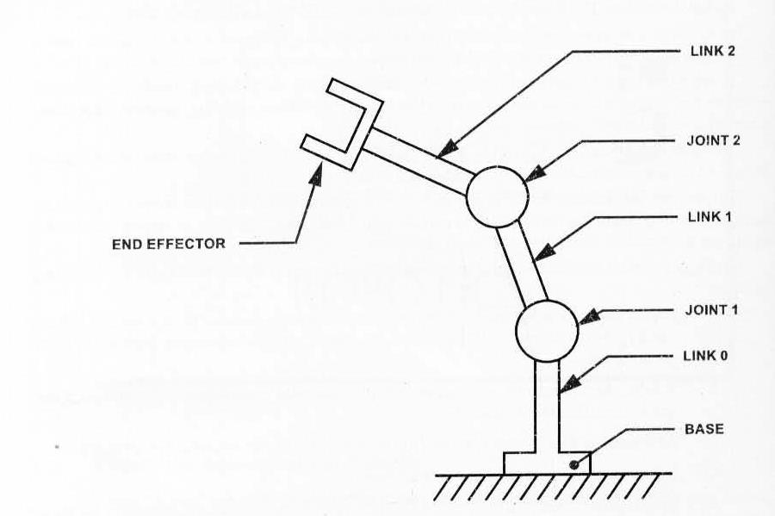
ROBOT

Slide 53
Elements of a Robotic System
A Robotic system has the following basic elements:
1. The Robot: This consists of
The Manipulator which includes the base and the arm assembly.
End-of-the-arm tooling which is the end-effector.
Actuators which convert stored energy into movement. Common actuators include electric motors and linear actuators.
Transmission elements such as ball screws, pulleys, belts, gears, etc.
2. Control System: The control system generates the required signals to co-ordinate and execute the robot movements. The Control System comprises of:
Controls such as Mechanical control, hydraulic control, pneumatic control, electrical or electronic control. The control techniques can be an open-loop (non-servo) control, feedback control, feed forward control and adaptive control.
Sensors that allows robots to collect information about a certain measurement of the environment or internal components. The sensors can be touch sensors or vision sensors.
Equipment Interfaces
3. Computer System: The Computer system is used to program the robots according to the tasks required to be performed. The necessary software must be installed in the computer to develop robot programs.
4. Power Source: Power source supplies electrical energy for the robot. The commonly used power source is the battery which can be a lead-acid battery or a silver-cadmium battery.

Slide 54
Types of Automation
Automation is categorized into three types. They are,
1) Fixed Automation
2) Programmable Automation
3) Flexible Automation.

Slide 55
Types of Automation
Fixed Automation
Fixed Automation:-
It is the automation in which the sequence of processing or assembly operations to be carried out is fixed by the equipment configuration.
In fixed automation, the sequence of operations (which are simple) are integrated in a piece of equipment. Therefore, it is difficult to automate changes in the design of the product.
It is used where high volume of production is required Production rate of fixed automation is high. In this automation, no new products are processed for a given sequence of assembly operations.

Slide 56
Types of Automation
Fixed Automation
Features:-
      High volume of production rates,
      Relatively inflexible in product variety (no new products are produced).
      High initial investment for custom-engineered equipment
      High production rates
Examples:-
      Automobile industries.
      Machining transfer lines and automated assembly machines

Slide 57
Types of Automation
Programmable Automation
It is the automation in which the equipment is designed to accommodate various product configurations in order to change the sequence of operations or assembly operations by means of control program. Different types of programs can be loaded into the equipment to produce products with new configurations (i.e., new products).
It is employed for batch production of low and medium volumes. For each new batch of different configured product, a new control program corresponding to the new product is loaded into the equipment. This automation is relatively economic for small batches of the product

Slide 58
Types of Automation
Programmable Automation
Features:-
      High investment in general purpose,
      Lower production rates than fixed automation,
      Flexibility & Changes in products configuration,
      More suitable for batch production.
Examples:-
      Industrial robot
      NC machines tools

Slide 59
Types of Automation
Flexible Automation
A computer integrated manufacturing system which is a extension of programmable automation is referred as flexible automation. It is developed to minimize the time loss between the changeover of the batch production from one product to other while reloading.
The program to produce new products and changing the physical setup i.e., it 4 produces different products with no loss of time. This automation is more flexible in interconnecting work stations with material handling and storage system

Slide 60
Types of Automation
Flexible Automation
Features:-
      High investment for a custom engineering system.
      Medium Production rates
      Flexibility to deal with product design variation,
      Continuous production of variable mixtures of products.
Example:-
      Flexible manufacturing systems (FMS)

Slide 61
Types of Automation
Advantages of Automation
      High Production rates
      Lead time decreases
      Storing capacity decreases
      Human errors are eliminated.
      Labour cost is decreases.
      Dis-Advantages of Automation
      Initial cost of raw material is very high
      Maintenance cost is high
      Required high skilled Labour
      Indirect cost for research development & programming increases.

Slide 62
ROBOT
Classification of Robot based on Robot configuration:
➢ Polar configuration
➢ Cylindrical configuration
➢ Cartesian configuration
➢ Joint arm configuration

Slide 63
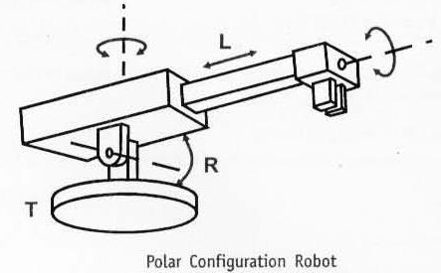
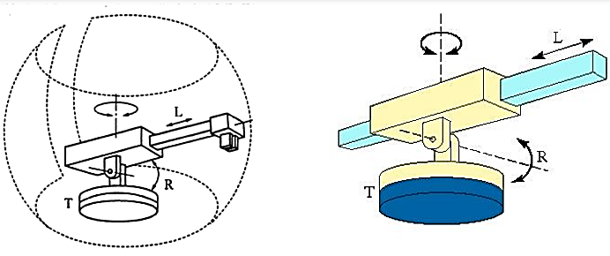
ROBOT
Polar Configuration (Spherical Configuration):
The Polar configuration robots, also called the spherical configuration robots, consist of a sliding arm (L-joint) that is actuated relative to the body and a rotational base along with a pivot, which can rotate about a horizontal axis (R-joint) and the vertical axis (T-Joint). This is shown in the Fig.

Slide 64
ROBOT
The one linear and the two rotary joints create a spherical work volume in which the robot operates.
Example: The Unimate 2000 series robot. (Courtesy: Unimation Inc.)
Advantage:
Long reach capability is realized in the horizontal position.
Disadvantage:
The vertical reach is low.
Applications:
Die casting, forging, injection molding, dip coating, cleaning of parts, etc. ​

Slide 65
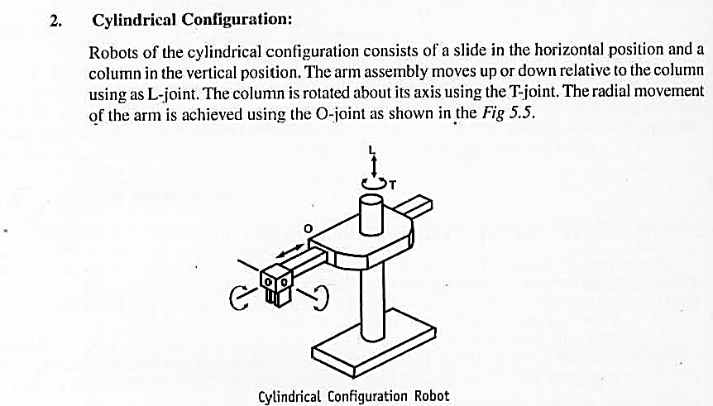
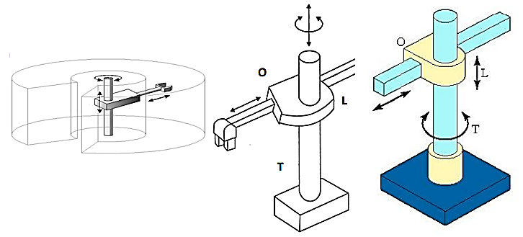
ROBOT
Cylindrical Configuration:
Robots of the cylindrical configuration consist of a slide in the horizontal position and a column in the vertical position. The arm assembly moves up or down relative to the column using an L-joint. The column is rotated about its axis using the T-joint. The radial movement of the arm is achieved using the O-joint, as shown in Fig.

Slide 66
ROBOT
Example: Model 1A Robot of GMF Robotics Corp. (Courtesy: GMF Robotics Corp.)
Advantages:
1. Rigidity is increased and is quite robust.
2. Has the capacity to carry high payloads.
Disadvantages:
1. Work volume is less.
2. Occupies more floor space.
Applications:
Foundry and forging applications, investment casting, conveyor pallet transfers,
machine loading and unloading

Slide 67
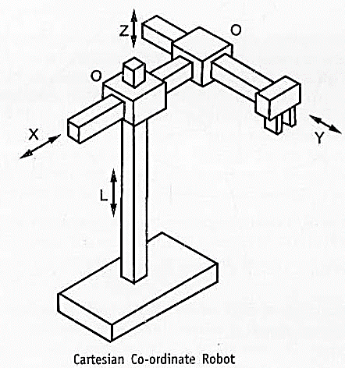
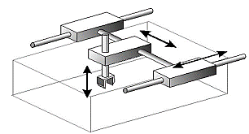
ROBOT
Cartesian Co-ordinate Robot:
It is also called as a rectilinear robot or a XYZ Robot. It consists of three sliding joints along the X, Y and Z directions in three dimensional space. There are two orthogonal joints. Since movement can stop and start simultaneously along the X, Y and Z axes, the motion of the tool tip is smoother. A typical Cartesian co-ordinate Robot is shown in the Fig.

Slide 68
ROBOT
Advantages:
Allows for simpler controls.
Possess a high degree of mechanical rigidity, accuracy and repeatability.
They can carry heavy loads and the weight lifting capacity do not vary within the work envelope.
Disadvantages:
Limited in their movement to a small and rectangular work space.
Reduced flexibility.
Applications:
To perform pick and place tasks, material handling, loading/unloading and machining operations

Slide 69
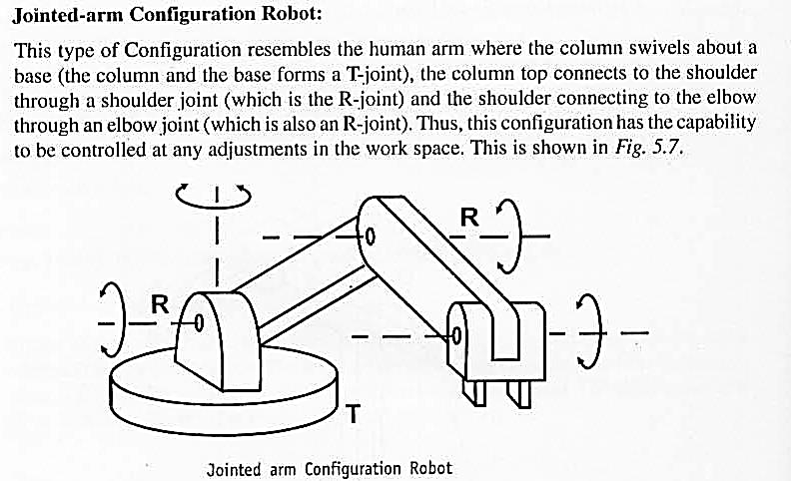
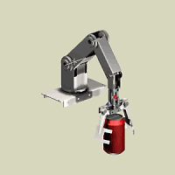
ROBOT
Jointed-arm Configuration Robot:
This type of Configuration resembles the human arm where the column swivels about a base (the column and the base forms a T-joint), the column top connects to the shoulder through a shoulder joint (which is the R-joint) and the shoulder connecting to the elbow through an elbow joint (which is also an R-joint). Thus, this configuration has the capability to be controlled at any adjustments in the work space. This is shown in Fig.

Slide 70
ROBOT
Advantages:
The work volume available is large.
Operation is quick.
Flexibility is increased.
Disadvantages:
Operating procedures are difficult.
Quite expensive type of configuration
Number of components involved are more.
Applications:
To perform arc welding, spot welding and spray painting operations

Slide 71
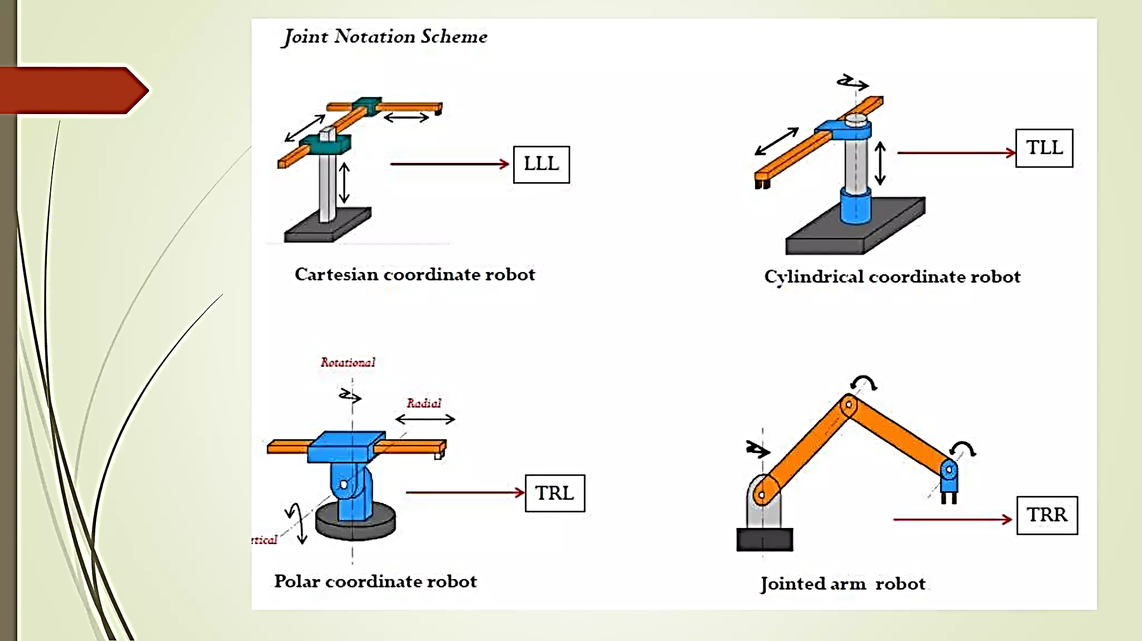
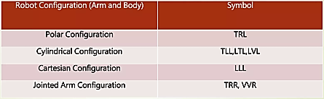
ROBOT
L-Linear Joint
T-Twisting Joint
R-Rotational Joint
V-Revolving Joint

Slide 72
Applications of Robot
Material/Part Handling applications
Most of the applications of the Robot falls under this category. Here the Robots are used to Transfer materials from one location to another location. Typical applications are as given below:
a. Pick-and-place application: The most common and simplest application here is the pick-and-place application where objects are picked from one location and placed to another location.
b. Palletizing application: Another application that is slightly complex is the "Palletizing application" where the robot stacks products or carton boxes onto a pallet at various positions on the pallet to the required height. Example KUKA model KR 40 PA that can stack pallets upto 1.6 metre height and that has a payload carrying capacity of 40 kg (Courtesy of Kuka Robotics Corporation). The Robot picks from the same location, but is programmed to place at different locations on the pallet in the stacking row and column order. Here we use the teach-and-play method or program to compute the location of carton box by taking into account the center distance between the carton boxes and the box dimensions of length x width x height.

Slide 73
Applications of Robot
Material/Part Handling applications
c. Depalletizing application: Here the robot picks parts from an orderly stacked pallet to another location. Example: FANUC Robotics M-410iB/140H can handle 140 kg payload and can palletize and depalletize boxes and bags (Courtesy: Fanuc Corporation).
d. Stacking application: Here, the robots are used to stack parts one upon another. After each placement, the vertical position is re-calculated and the new stacking height is determined. Example: FANUC M-2iA robot (Courtesy: Fanuc Corporation) was used by an organization to stack stamped parts on conveyors.
e. Insertion operation: Here, the robots are used to insert parts into the compartments or spaces provided in a carton.

Slide 74
Applications of Robot
Machine loading/unloading
a. Machine loading/unloading: In the machine loading/unloading application, a robot is used to move the work parts to or/and from the production machine.
The following three possibilities can be included for the loading/unloading application:
b. Machine loading: In the loading operation, a robot is used to load parts into the production machine, but the unloading of the finished parts after completion of operations of the production machine is done by means other than the use of a robot. Example: This is commonly applied in Press working process.
c. Machine unloading: In the unloading operation, a robot is used to unload the finished parts that comes out of a production machine, but the loading of the parts on to the production machine is done by means other than the use of a robot. Example: Die casting and plastic modelling.
d. Machine loading and unloading: In this operation, a robot is used to both load raw parts into the production machine and unload finished parts from the production machine. Example: Machining operation

Slide 75
Applications of Robot
Machine loading/unloading
Following are the industrial applications of robots used for machine loading/unloading:
Die-casting: Here the robot is used to safely unload the parts from a die-casting machine with the safety gates closed. Other connected applications are carrying out cooling tasks or parting agent applications.
Forging: Forging is one of the toughest environments considering the extreme heat, pollution and noise. The use of a robot immensely helps to face the environment of forging. Here the robot loads the red hot billet on to the die of the forging hammer, holds it during the blows and unloads to a safe place away from the hammer.

Slide 76
Applications of Robot
Machine loading/unloading
Plastic injection moulding: Here a robot unloads parts from the injection moulding machine, cuts the runner and drops runner to scrap area.
Sheet metal press operation (Press working): Here a robot loads a blank into the press, then after the press stamping operation is performed the robot unloads the scrap and throws it into the scrap area. The stamped parts from the blank falls in the container placed at the back of the machine.
Machining operations: Here the robot loads the raw blanks on to the machine tool and unloads the finished parts.
Heat treating: Here the robot loads/unloads parts to/from a furnace.

Slide 77
Applications of Robot
Processing operations
Robots are used to carry out the processing operations such as spray painting, spot welding, etc by using a tool at its end-effector. The tools can be a spray painting gun for spray painting operation, a spot welding gun for spot welding operation, etc.
In processing operations, the robot manipulates a tool to perform a process on the work part.
Following are few processes that use industrial robots:
a. Spot Welding: Spot Welding is a metal joining process where two metal parts are squeezed together between two electrodes and subjected to a large amount of current to form a joint at particular points or spots. The end-effector of the robot here is the spot welding gun that applies the approximate pressure and current to the sheet parts to be welded. The spot welding robots have enough number of axes of motion to approach points in the work envelope at any angle. This was difficult to realize in a manned environment in the absence of robots. Spot welding is used largely in the automobile industry to weld automobile bodies such as car panels.

Slide 78
Applications of Robot
Processing operations
b. Arc Welding: Arc welding is a metal joining process where metals are welded by using the heat generated by an electric arc. The welding here is continuous unlike spot welding. When arc welding is manually carried out, the conditions are difficult for the operators since they require Personal Protective Equipment like welding shield with special glass to avoid UV rays, are under the danger of operating at high temperatures involving high amount of heat and moreover they must be accurate in following the welding path. These problems are now overcome with the use of arc welding robots.

Slide 79
Applications of Robot
Processing operations
The typical components of an arc welding cell includes:
Arc welding robot: Most popular is the jointed-arm type robot because it allows the welding torch to be manipulated similar to a manual operator. The torch and travel angles can be changed to make welds of good quality. Also welding can be done in areas that are difficult to reach. These robots typically consist of five or six free programmable axes.
Power Source: This provides electric power required to do the arc welding operation.
Welding torch: This is carried by the robot as its end-effector tool to direct the welding electrode into the arc.
Wire feeder: These are used to add the filler material in robotic welding.
Welding fixtures: These hold the individual parts to be welded in proper alignment during welding.

Slide 80
Applications of Robot
Processing operations
C. Spray Coating: Spray coating is a process where parts are coated by a spray gun spraying the fluid on to the surface of the part. The fluid passes through the nozzle of the spray gun and is dispersed at high velocity to the surface to be coated. Common examples are powder coating and spray painting.
When human operators carry out the spray coating operations, it results in various health hazards such as the paint or powder fumes / particles entering the operator's body and causing illness, flash fires resulting in burning in the painting booth pit, ear damage due to continued noise of the nozzle, etc. Hence if affordable, robots can be the right substitution to work in such environments.
The robot end gripper is a spray coating gun which sprays the paint or coat on the work surface uniformly. The motion sequence must be smooth with continuous path control. Spray coating robots are used in coating of the exterior and interior parts of a car, spray staining of wood furniture for carousel presentation, applying stain to textiles (like Jeans material), spraying porcelain coating on bathroom fixtures, etc.
Benefits of spray coating robot includes:
1. Protecting human operators from hazardous coating environments
2. Consistency across coated parts is high
3. Better productivity
4. Uniform coating on the coated surface 5. Reduced paint wastage

Slide 81
Applications of Robot
Other Processing applications
a. Grinding: Here the end effector of the robot is the rotating spindle and the grinding wheel is mounted in the spindle chuck. The robot moves its arms relative to the workpiece and grinds the material of the workpiece. Manual grinding has problems like exposure of the operator to fast moving tiny ground particles leading to damage to the eyes and face, requirement of intensive training and grind mark patches. On the other hand, use of robots can give us the perfect grinding finish with saving of time and absence of hazards. As a connected application, robots are used to polish surfaces using a polishing wheel.
b. Drilling and other machining processes: The end-effector is the rotating spindle and the cutting tool is mounted in the spindle chuck.
Drilling a hole manually requires significant time and effort. Using robots in drilling helps to monitor drill speed, torque, countersinking, displacement and breaking of bits. The monitoring is done by sensors on the robots.
Aerospace industry uses robotic drilling due to the precision and productivity benefits. The only challenge of using robots in drilling and other machining operations is that the robot must handle the high cutting forces during machining.
Robots are now used in other machining processes like routing, milling, etc. The end-effector here are spindles on which appropriate tools are mounted according to these machining processes.

Slide 82
Applications of Robot
Other Processing applications
c. Plasma Cutting: Plasma cutting is a process that uses high velocity ionized gas called plasma to heat and melt metals. The plasma later blows away the molten material mechanically to cut the workpiece which is usually one inch thick. Use of robots here results in high quality cuts at faster travel speeds. The plasma torch is attached to the robot as its end-effector.
d. Laser Cutting: Laser cutting is a process that uses a high power laser through optics to cut materials. The laser tool as an end-effector is attached to the robot. The result of robotic laser cutting is precision cutting with high repeatability and accuracy.
e. Waterjet Cutting: Waterjet cutting is a process used to cut parts using a very high pressure stream of water. The nozzle ensures the high pressure of the water stream. When used with a robot, this nozzle becomes the end-effector and the arm moves in the programmed paths to achieve high quality cutting. Waterjet robots are used to cut various materials like metals, fabrics, board, plastic, etc. Waterjet robots is used in aerospace, automotive, textile, packaging and food industries. f. Other applications include wire brushing, deburring, fiberglass cutting, etc.

Slide 83
Advantages of Robot
Following are some important advantages of using Industrial Robots:
Robots can be substituted for humans to work in hazardous work environments. Example: During arc welding, in foundry environment, in powder coating environment, etc.
Robots can produce greater quantity in a short span of time with consistency and accuracy that cannot be matched by humans.
Robots can work at constant speeds without any break which is not possible by humans.
Robots are capable of lifting heavy loads without getting tired or injured.
Robots can work in tight spaces where human reach is not possible.
Robots can be re-programmed with changed tooling to take up a different task after the end of a batch or a production run. In such cases, robots are better than fixed automation.
Accidents at the workplace is avoided since robots perform the risky jobs which were otherwise done by humans.
Since Robots are controlled by computers, they can be integrated to other computer systems to realize Computer Integrated Manufacturing (CIM)
The usage of robots produces lesser or no defective parts and hence saves time of rework and money to the organization.

Slide 84
Disadvantages of Robot
Following are some disadvantages of using Industrial Robots:
Organizations have to make huge investments to introduce robots at their workplaces.
Since parts of a robot are made very precisely, their replacement is very difficult and to maintain, it costs huge amount of money.
To program and setup the robotic systems and robots, and to avoid unnecessary future problems and mishaps, it requires highly skilled technical engineers and programmers which again is a significant cost for the organization.
Unless the level of the artificial intelligence is highly sophisticated, robots may not be able to respond properly during times of emergency, during times of accidents or when an unexpected variance occurs.

